Slide 1
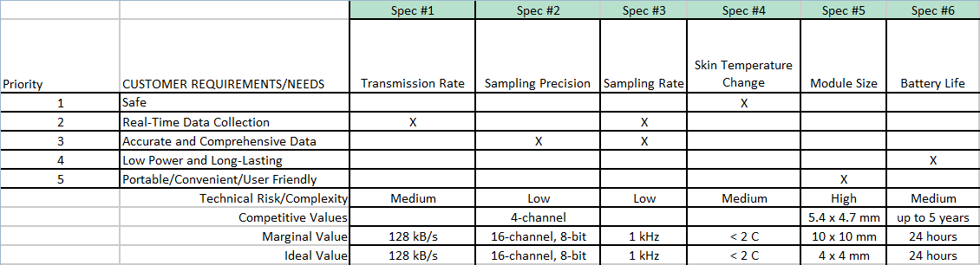
Design Specifications

Slide 2
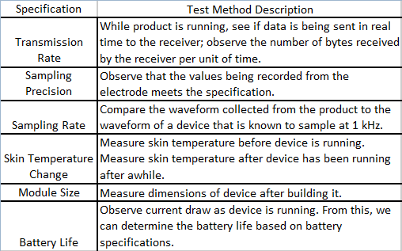
Testing Methods

Slide 3

System Diagram

Slide 4
References
http://www.neuropace.com/product/pdfs/UserManual.pdf
Wireless Neural Recording with Single Low - Power Integrated Circuit (2010)

